Slide 1


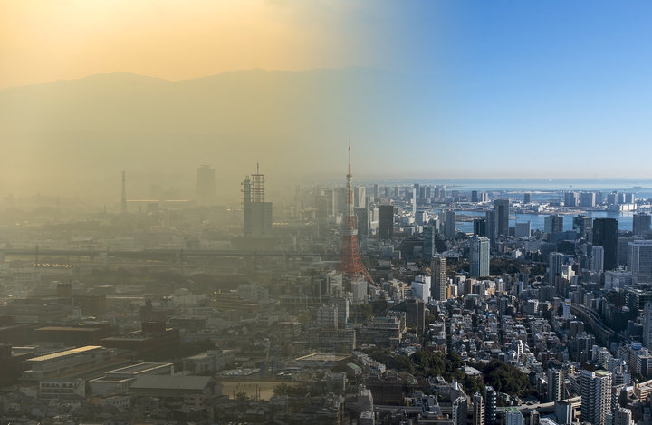
2018 Enviornment·Weather Big Data Competition held by NIA & K-Weather
Deep-Learning based Hourly Fine Dust Forecast
Team 902
2nd December 2018

Slide 2
Please be noted that it is not allowed to disclose such confidential data & information in violation of the Non Disclosure Agreement between K-Weather and Team902. Hence, we are not be able to share the E.D.A, Preprocessing and Modeling section in detail.
Contents
1. Problem Recognition
2. E.D.A & Preprocessing
3. Modeling
4. Result & Evaluation
5. Conclusion
6. Feasibility Analysis
#. Reference
#. Competition Result

Slide 3
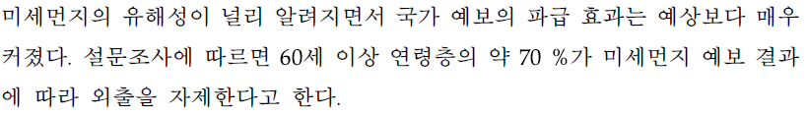
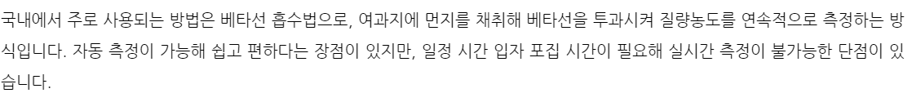
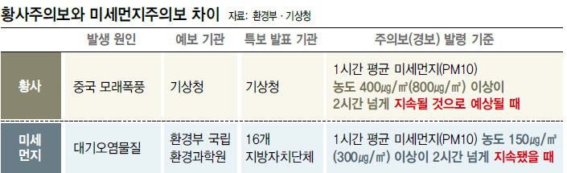
1. Problem Recognition
Topic : Forecasting fine dust concentration on an hourly basis
Fine dust limits our outdoor activities nowadays
The current system for forecasting fine dust is not ‘forecast’ but ‘notification’.
As of December 2018, the “Beta-ray Attenuation Method” which has been using by K-Weather is just for gauging fine dust concentration. It’s impossible for the method to predict fine dust concentration
> It is necessary to predict fine dust concentration on a real time basis

Slide 4
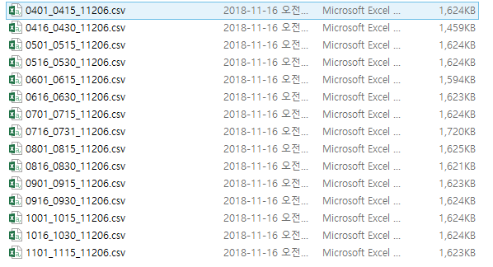
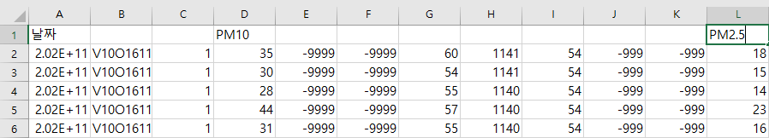
2. E.D.A & Preprocessing
1) Integrate 16 different air quality datasets into a “Combined Dataset” file (180401~181115)
2) Take “Date(Year+Month+Day+Minute)”, “PM10”, “PM2.5 “ from the dataset (followed K-Weather’s guideline)

Slide 5
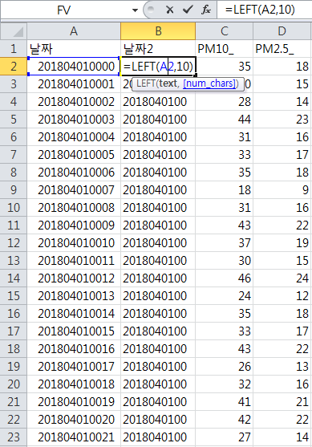
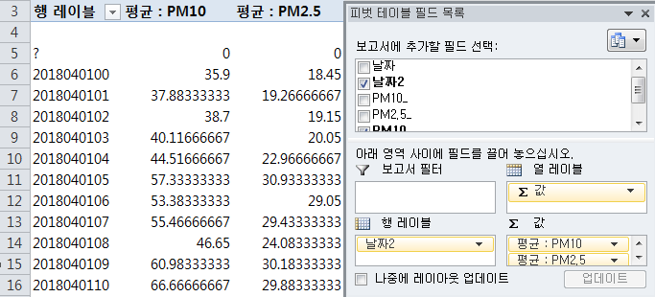
2. E.D.A & Preprocessing (Cont’d)
3) Transform “Minute” data to “Average per hour”
- Date
- Fine dust concentration

Slide 6
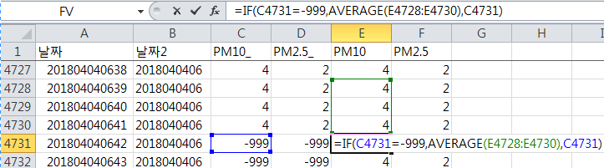
2. E.D.A & Preprocessing (Cont’d)
4) Missing value imputation
- Date: Replace the missing values with the values from the data which is nearest one
Eliminate the missing value on 31st of August, since it’s not existing in all the other datasets
- Fine dust concentration: (-999)value → Replace with the average of first three hours before the value

Slide 7
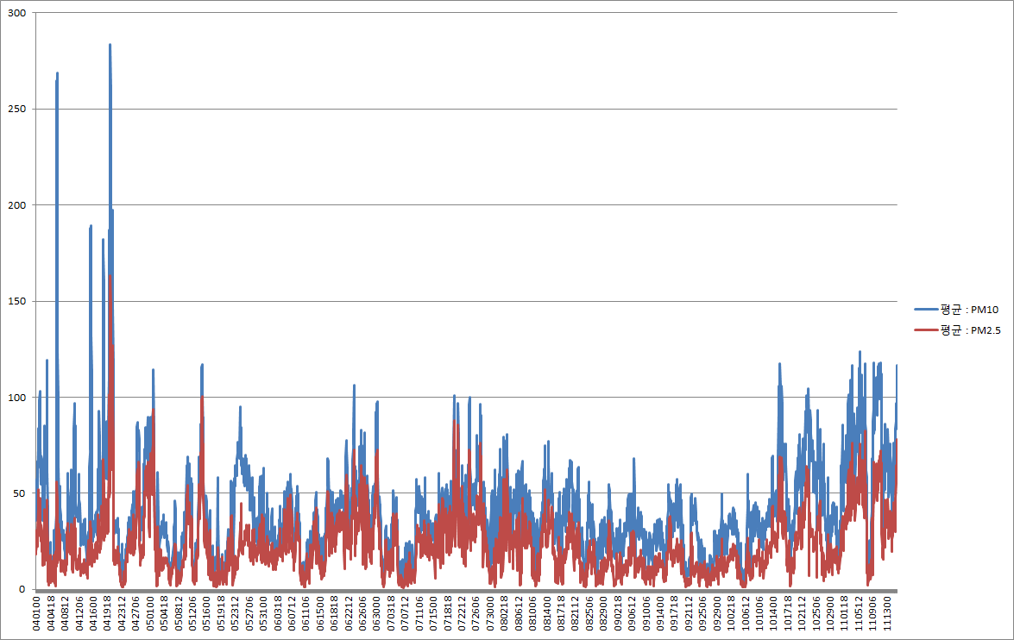
2. E.D.A & Preprocessing (Cont’d)
5) Split trainset & test set
Trainset ➔ ‘Seolleung Station’ dataset / Testset ➔ All the other datasets
Measurement of fine dust concentration from the measuring device no.57
(Seollung Station)

Slide 8
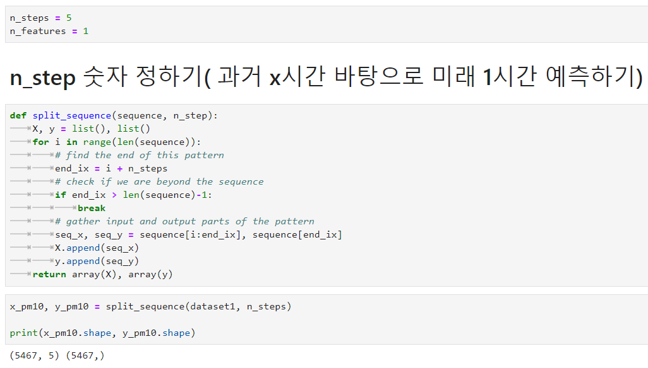
3. Modeling
Use ‘5’ as optimal value for ‘n_steps’
(If n_steps is low, accuracy would decrease. If n_steps is high, efficiency would decrease)
Forecast the fine dust concentration of 1 hour later, based on the data of the past 5 hours
Reshape the data with sequencing 5 hours

Slide 9
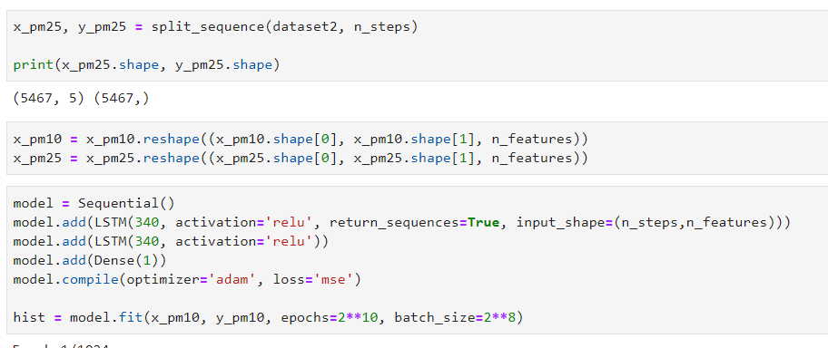
3. Modeling (Cont’d)
Reshape the data with sequencing 5 hours (Cont’d)
Use LSTM algorithm for Time Series Analysis

Slide 10
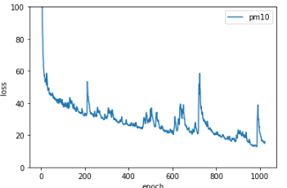
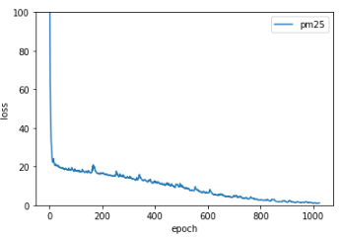
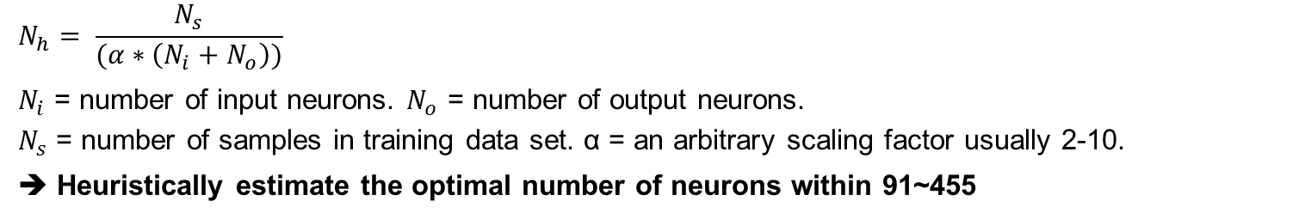
3. Modeling (Cont’d)
Find out the optimal number of neurons
The method that helps for supervised learning problems.
The upper bound on the number of hidden neurons that won't result in over-fitting is:
$$N_{h}= \frac{N_{s}}{(α∗\left(N_{i}+N_{o}\right))}$$
$N_{i}$ = number of input neurons. $N_{o}$ = number of output neurons.
$N_{s}$ = number of samples in training data set. α = an arbitrary scaling factor usually 2-10.
➔ Heuristically estimate the optimal number of neurons within 91~455
Modeling
Learning Process for PM10
Learning Process for PM2.5

Slide 11
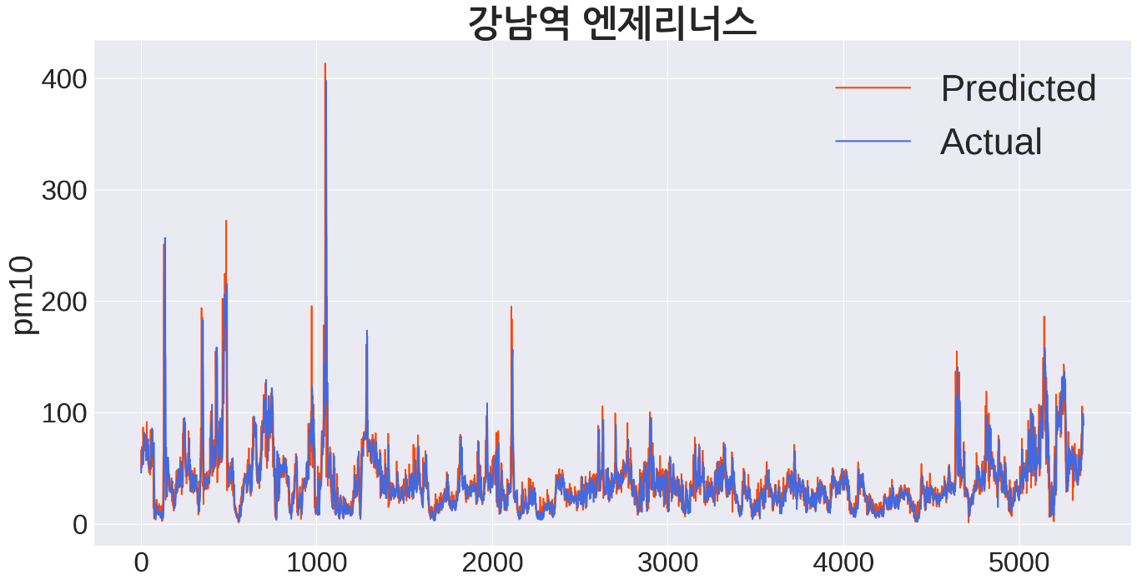
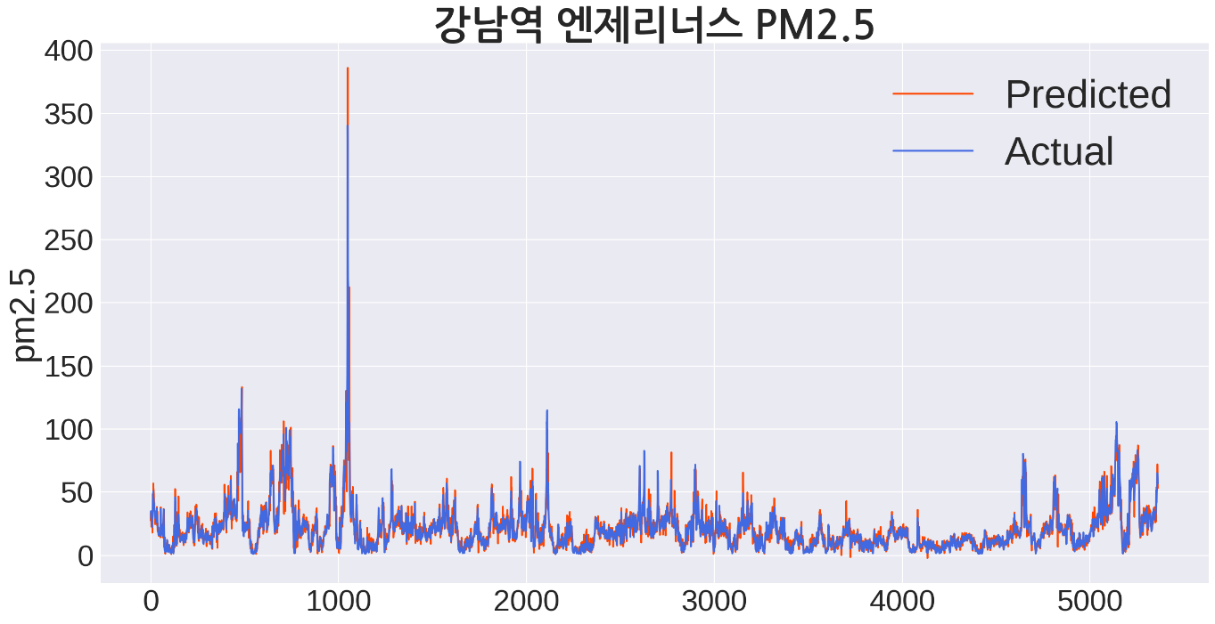
4. Result & Evaluation
Prediction result at ‘Gangnam branch of Angelinus’
Unit: ㎍/㎥
PM10 (RMSE) = 9.17
PM2.5 (RMSE) = 6.70

Slide 12
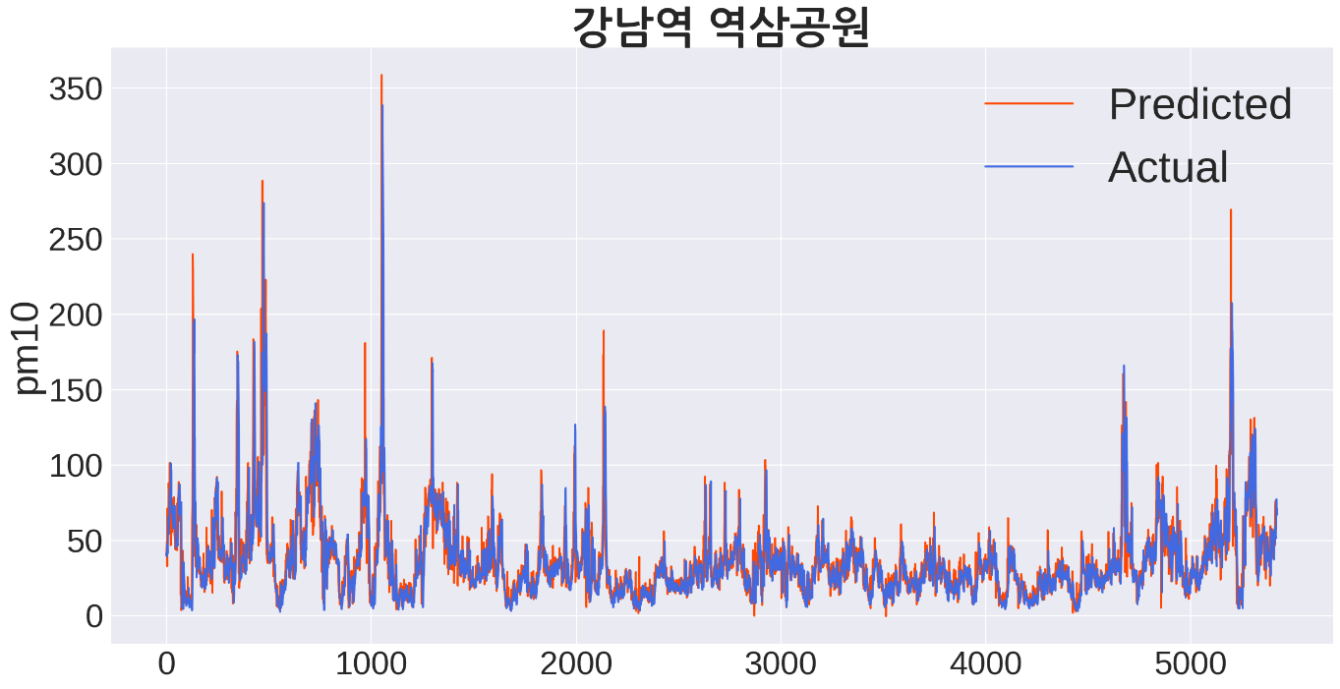
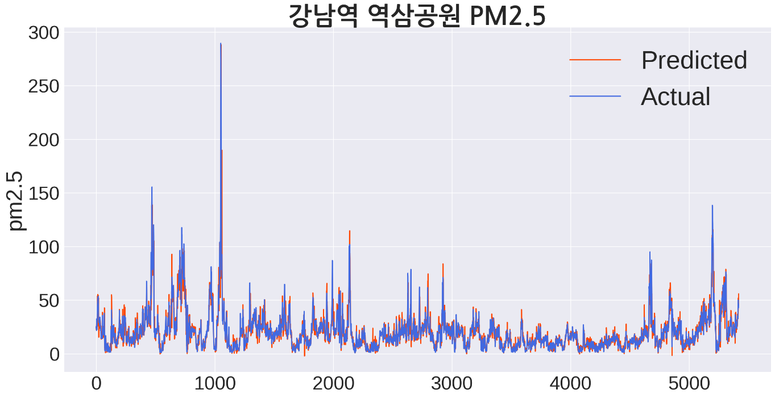
4. Result & Evaluation (Cont’d)
Prediction result at ‘Yeoksam Park’
Unit: ㎍/㎥
PM10 (RMSE) = 9.08
PM2.5 (RMSE) = 6.30

Slide 13
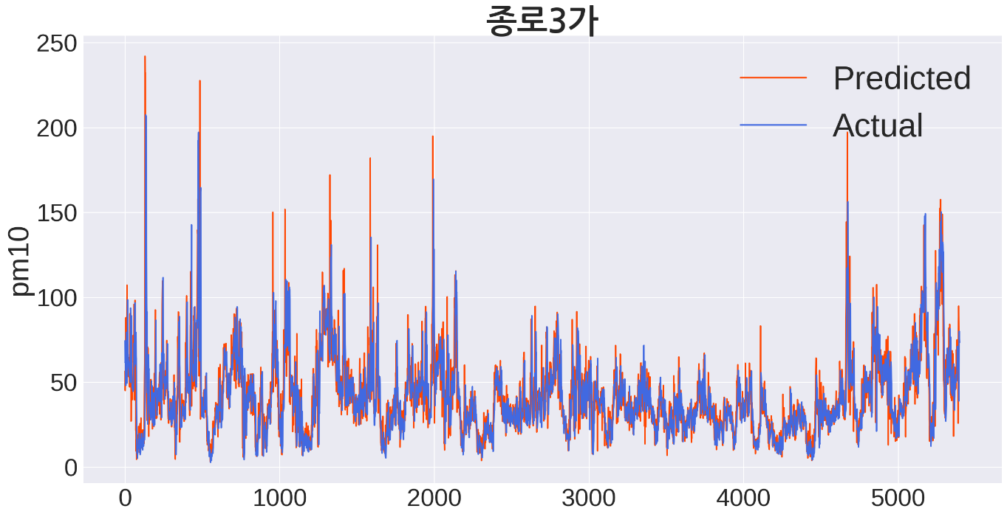
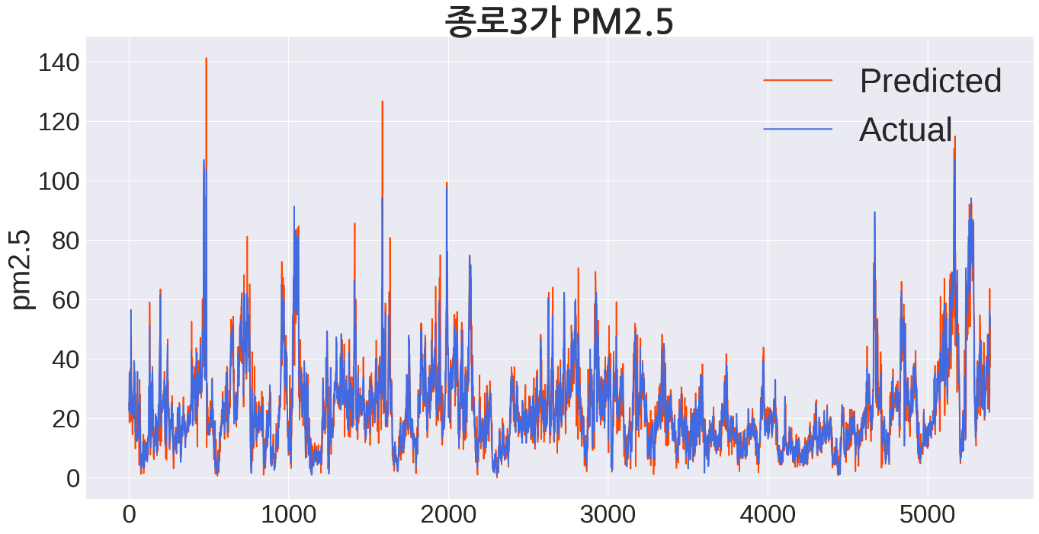
4. Result & Evaluation (Cont’d)
Prediction result at ‘Jongno 3(sam)-ga’
Unit: ㎍/㎥
PM10 (RMSE) = 8.65
PM2.5 (RMSE) = 6.06

Slide 14
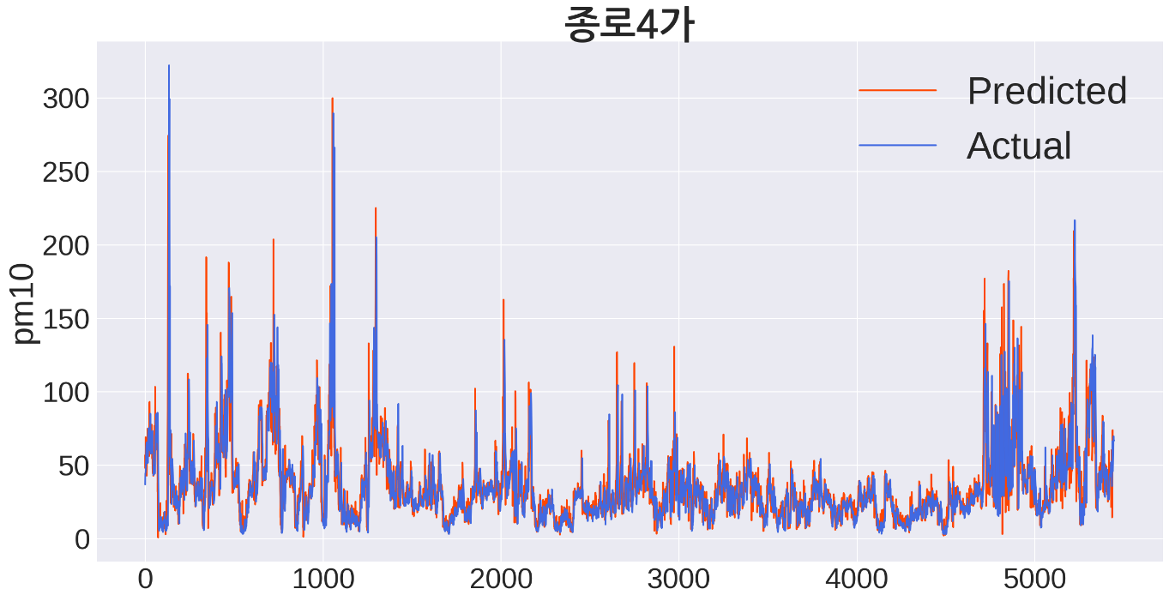
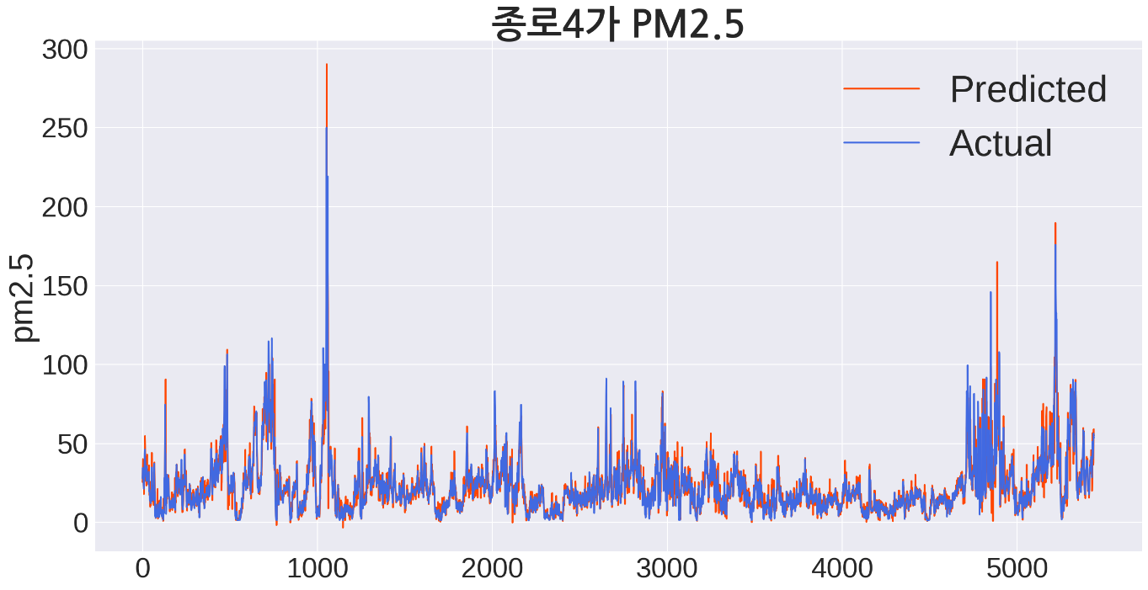
4. Result & Evaluation (Cont’d)
Prediction result at ‘Jongno 4(sa)-ga’
Unit: ㎍/㎥
PM10 (RMSE) = 11.10
PM2.5 (RMSE) = 8.56

Slide 15
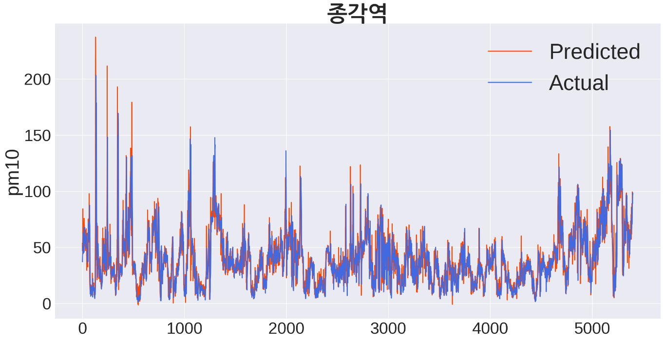
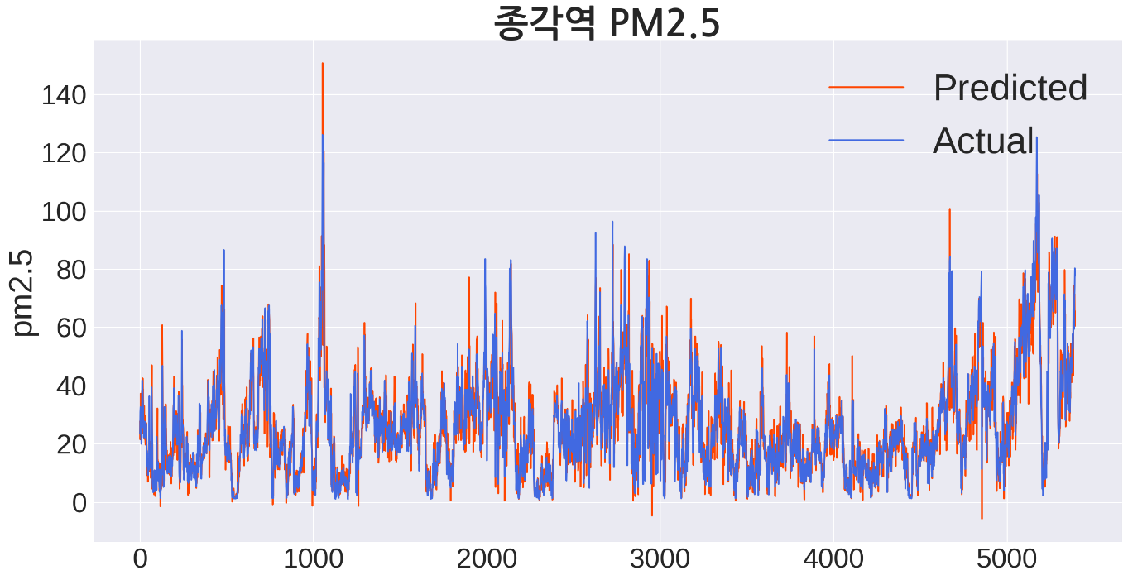
4. Result & Evaluation (Cont’d)
Prediction result at ‘Jonggak Station’
Unit: ㎍/㎥
PM10 (RMSE) = 8.53
PM2.5 (RMSE) = 6.90

Slide 16
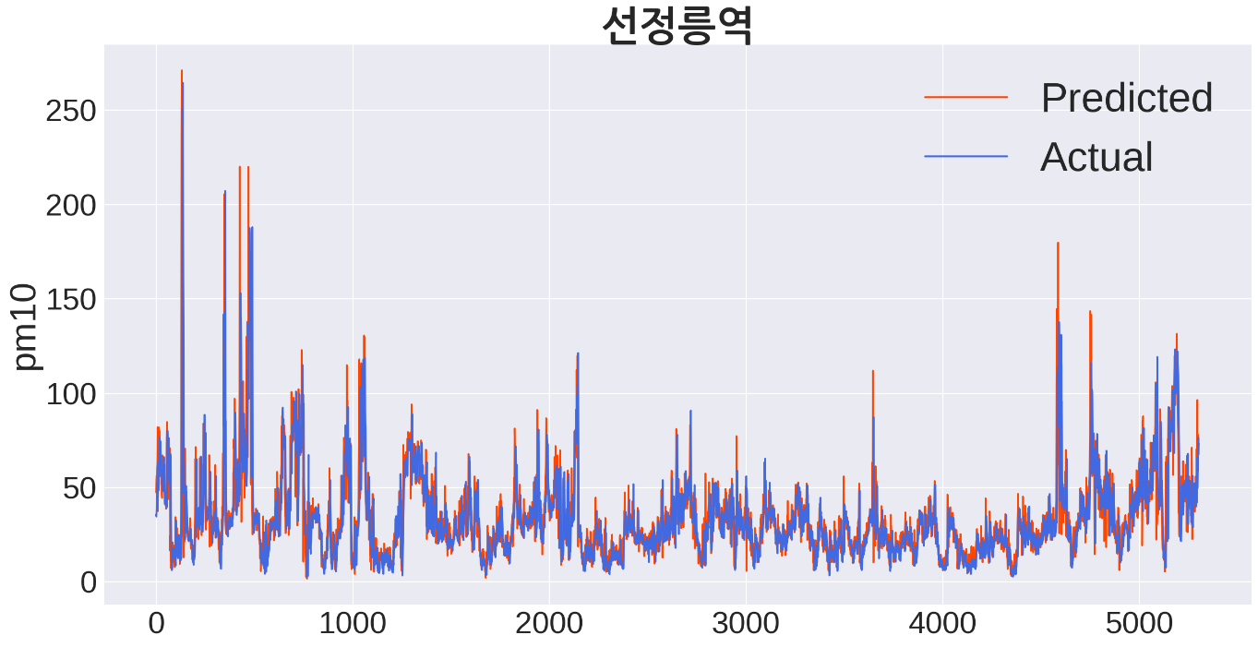
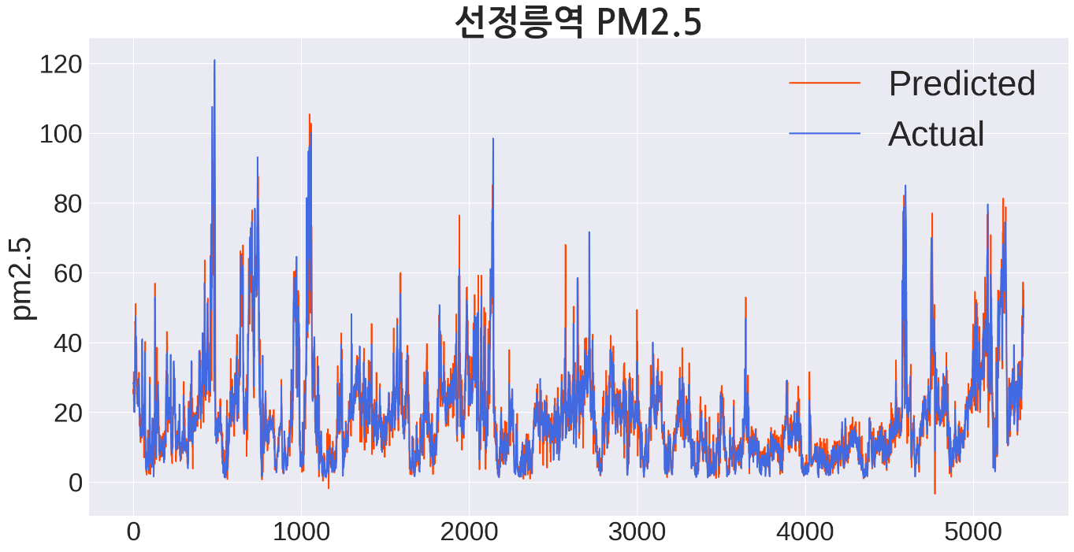
4. Result & Evaluation (Cont’d)
Prediction result at ‘Seonjeongneung Station’
Unit: ㎍/㎥
PM10 (RMSE) = 8.42
PM2.5 (RMSE) = 5.31

Slide 17
5. Conclusion
Result & Evaluation
Learning time for each model: 40mins (based on i7 CPU)
The model might be overfitted
Model is built with excellence performance contrasted with the amount of data and learning time
Limitation
Able to improve performance when secure data before 2018
Able to make more generalised model by supplementing seasonal periodicity of model if it secures winter data
In case of PM 2.5, it is possible to decrease error if additional learning time is secured.

Slide 18
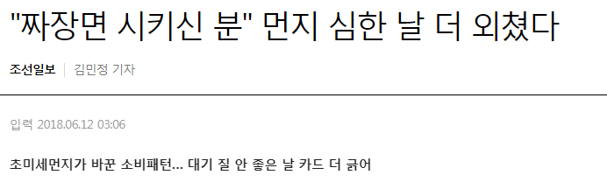
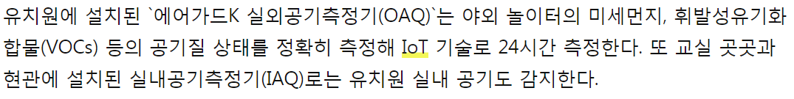
6. Feasibility Analysis
Support real-time decision making by predicting on an hourly basis
Decline of economic cost such as time and cost to establish execute countermeasure for fine dust from government such as running sprinkle truck
Predict consumer’s purchasing pattern and make maneuver possible by offering information to industry which is influenced by fine dust such as restaurant business
Provide information to families, kindergartens, schools and by supporting decision making such as turning on air cleaner at right timing or outdoor activities, help saving energy and healthcare.
Existing forecast of fine dust needs lots of types and a number of data and has big disadvantage, complexity of calculation. However, if we use deep-learning based forecast, we can establish low cost needed and high efficient forecast system.

Slide 19
# Reference
며칠째 미세먼지 예보 아닌 '중계'만…"믿고 나갈 수가 없다"
http://news.jtbc.joins.com/article/article.aspx?news_id=NB11735698
황사와 미세먼지 무엇이 다르냐면요…
http://www.hani.co.kr/arti/society/society_general/733554.html
미세먼지 예보는 어떻게 측정할까? 미세먼지 측정 방법과 기상과의 관계
https://blog.naver.com/mesns/221384758930
(환경부 공식 블로그)
국가 대기질 예보 정확도 향상 연구 (I) 2014, 기후대기연구부 대기질통합예보센터, 국립환경과학원
발간등록번호 11-1480523-002196-01
"짜장면 시키신 분" 먼지 심한 날 더 외쳤다
http://biz.chosun.com/site/data/html_dir/2018/06/12/2018061200016.html
케이웨더 "유치원 에어가드K 설치로 야외활동 결정하세요“
http://www.etnews.com/20160614000111

Slide 20
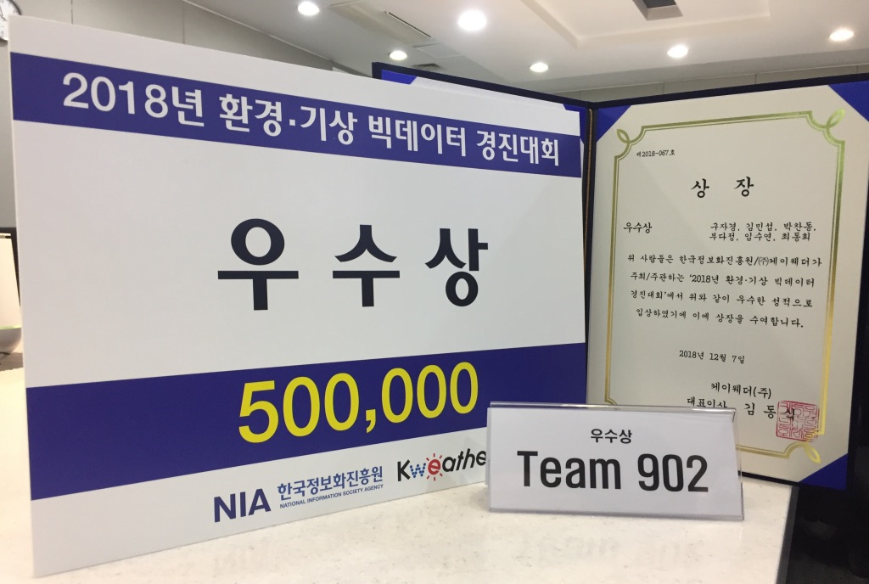
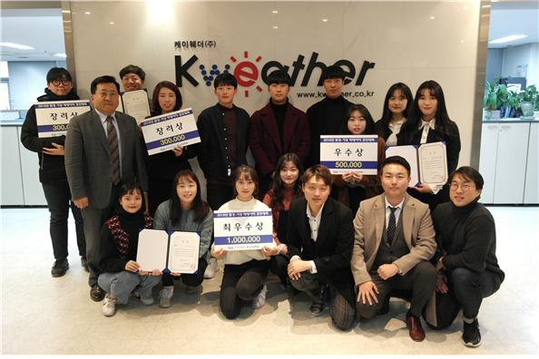
# Competition Result
“공기 빅데이터분석으로 미세먼지 쉼터를 만들자”
http://www.edaily.co.kr/news/read?newsId=01223446619436880&mediaCodeNo=257
케이웨더 "공기 빅데이터분석으로 미세먼지 쉼터 만들자“
http://daily.hankooki.com/lpage/society/201812/dh20181210112402137890.htm

